Slide 1
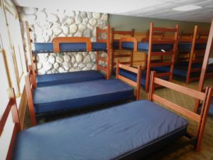
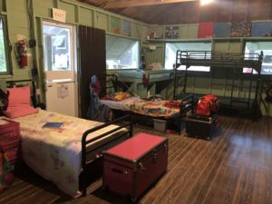
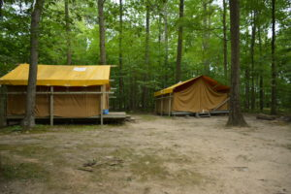
Dormitories
Bunk with 10-20 of your closest friends in air conditioning and full electricity!
$50 per person per night
Cabins
Get the full parent trap experience in cabins with lights but no outlets and a short walk to the lodge for bathrooms.
10 cabins that sleep up to 12 people available
$50 per person per night
Platform Tents
Looking for a quieter more rustic experience – canvas platform tents are available. They are a bit away from the main lodge but have water running to them and an outhouse near them.
$50 per person per night

